Slide 1

LTF Challenge- Farmer Income Prediction presented by team: z-fighters Members:[Shyam Banerjee, Shaswat Pratiyush, Ahan Mukherjee, Molugu Sai Pranav Reddy] Institution: ISI Kolkata Date: 30.07.2025

Slide 2
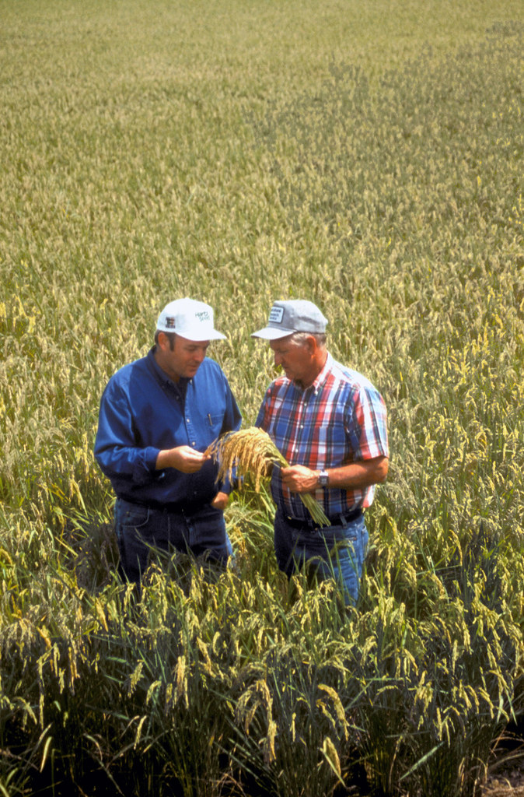
1) problem overview
Context:
A significant number of Indian farmers face rejection when applying for loans due to lack of verifiable income data.
Financial institutions, like L&T Finance, need a reliable method to estimate a farmer’s income to improve credit access while minimizing lending risk.
Goal:
To develop a machine learning model that predicts a farmer’s income based on diverse information — demographic, climatic, agricultural, and infrastructural data — to guide credit risk assessment.
This Photo by Unknown Author is licensed under CC BY

Slide 3
2) Data landscape
Provided data:
Tabular Dataset with farmer-level and regional attributes:
Demographics: gender, marital status, social category
Agriculture: landholding, crop data (rabi & kharif)
Climate: rainfall, temperature, groundwater levels
Living Conditions: house type (& size), electrification, sanitation, amenities
Credit History: loans availed, disbursement history, non-agricultural income
Data characteristics:
47,970 farmers in training data, with 105 features
1700+ features after one-hot encoding and preprocessing
Mix of categorical, numerical, and geospatial variables
Missing values and non-standard text formats in several columns
Challenges:
High dimensionality and multiple collinearity
Varying data density across states (e.g., some regions have sparse data)
Potential for distribution shift across train and test districts

Slide 4
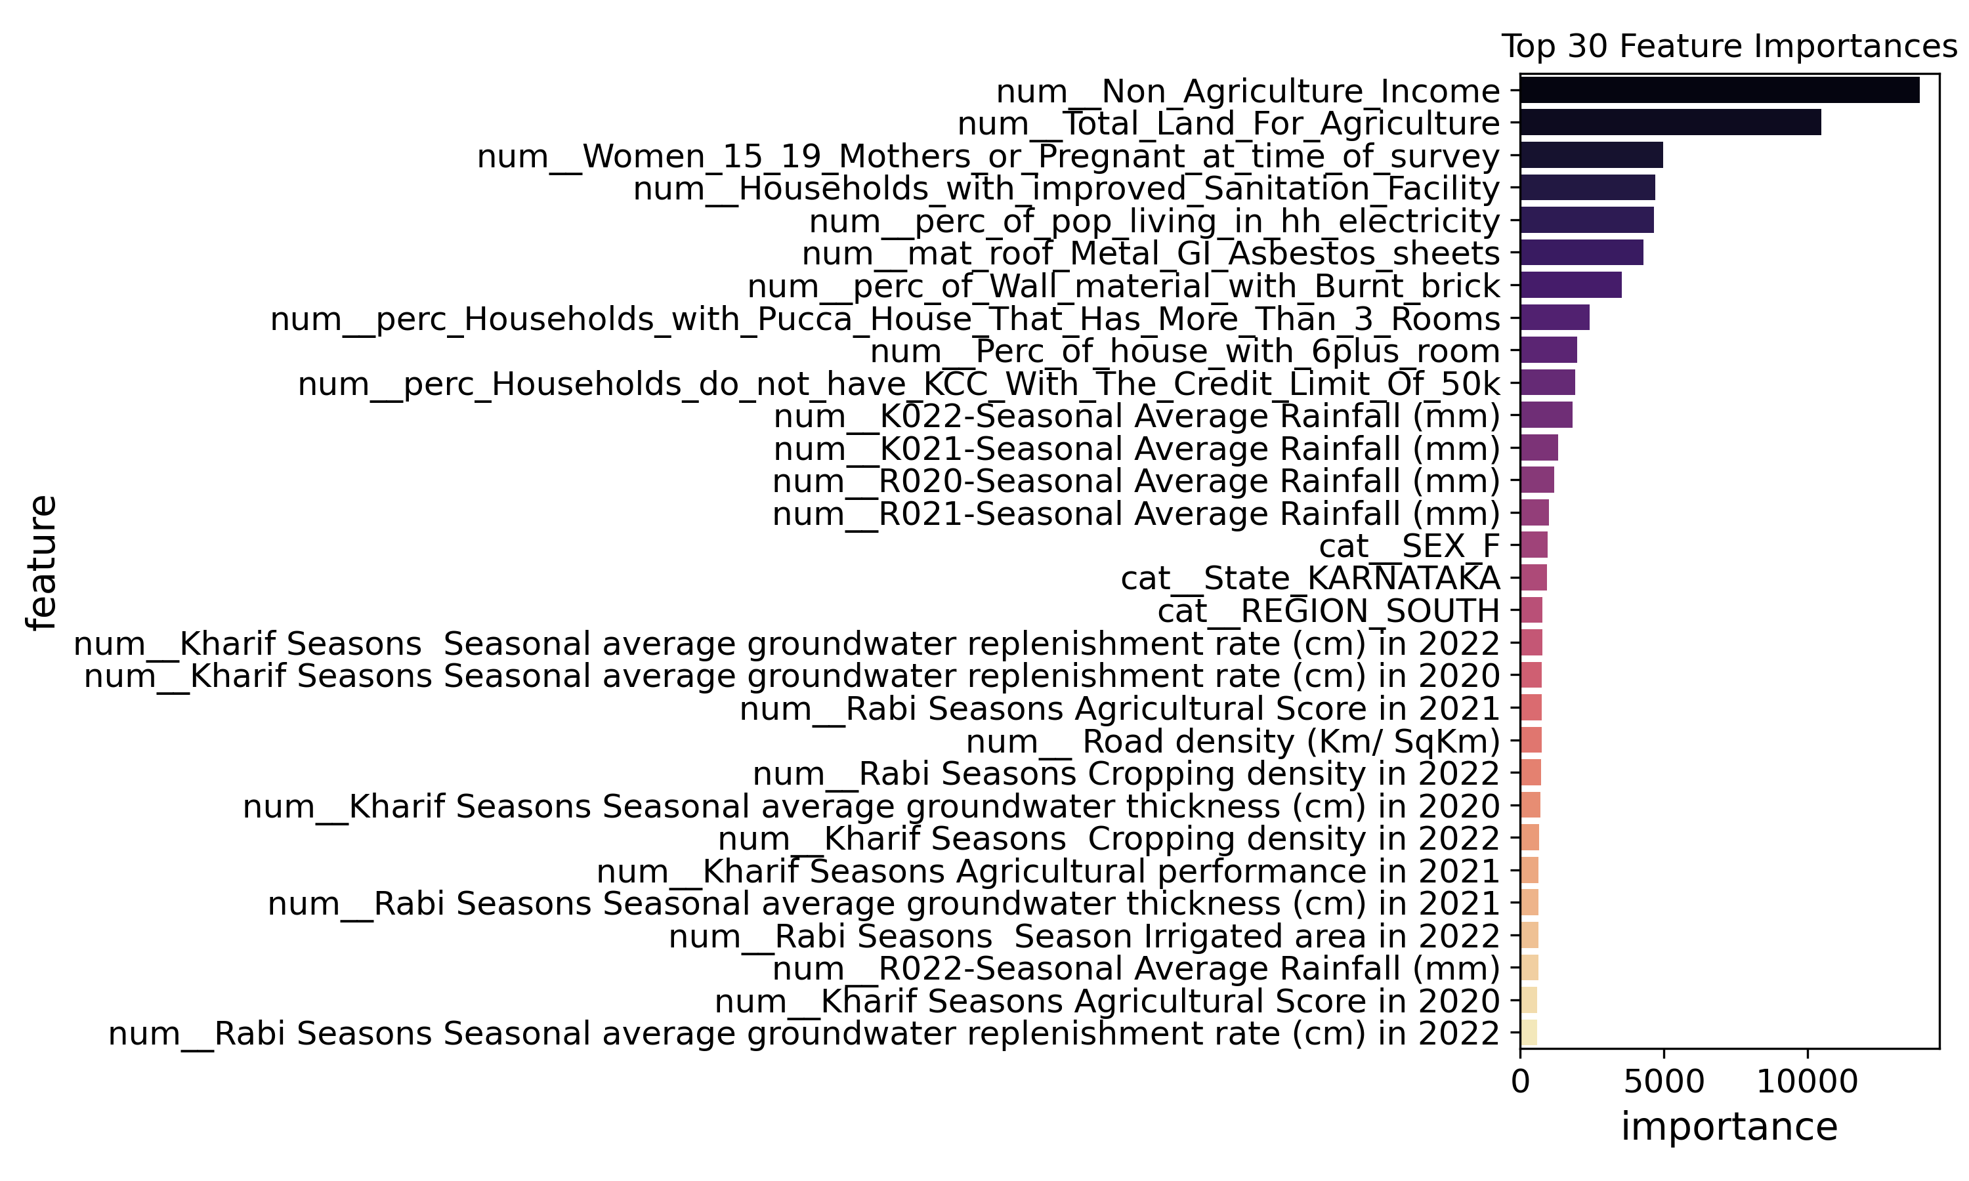
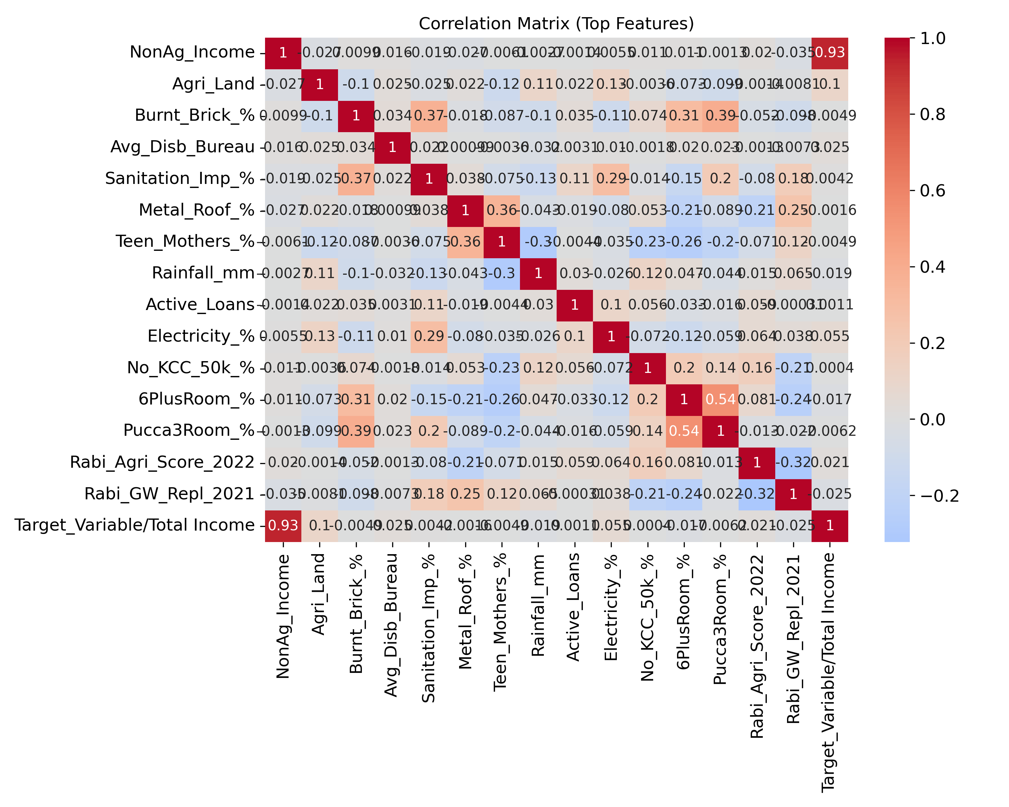
3) Exploratory data analysis (EDA)
Fig. Top 30 Feature Importances
Fig. Correlation matrix (for top 15 features)

Slide 5
4) Data Preparation & Preprocessing
1. Missing Value Handling:
Applied SimpleImputer:
Numerical: ‘median’ imputation
Categorical: ‘most_frequent’ imputation
For low-signal columns with excessive missingness, dropped after EDA.
2. Encoding and Transformation:
Categorical: One-hot encoded using `ColumnTransformer`
Numerical: Standardized using `StandardScaler`
Combined in a unified scikit-learn `Pipeline`
3. Dimensionality reduction (experimental):
PCA tested but not retained --- results from tree models on full pipeline yielded better training
4. Train-Validation split:
Simple random 80/20 split on total train_data using `train_test_split` to simulate the model’s generalizability based on underlying demographic and socioeconomic numerical features rather than overfitting to geographic identities like State.
(However, a geographical split can be revisited during robustness checks—e.g., testing on an unseen state—as a form of out-of-distribution evaluation.)

Slide 6
5) Modelling approach
1. Baseline models tested:
Linear Regressor (Ridge Regressor)
Random Forest Regressor
Gradient Boosting Regressor (XGBoost, LightGBM)
Support Vector Regressor
2. Final models explored:
LightGBM: Best model (Validation MAPE: ~ 22.257% )
Tuned via Optuna Bayesian Optimization (50 trials)
Used dart boosting, regularization (reg_alpha, reg_lambda)
Early stopping with `eval_metric=‘mape’`
RandomForest: Second best model (Validation MAPE: ~ 23.46%)
Tuned via Optuna Bayesian Optimization (50 trials)
Simpler, robust to outliers but slightly less performant
Stacking Models:
Combined XGBooster, RandomForest and Ridge regressor models
Underperformed compared to standalone RandomForest
3. Model export:
Exported best model `lgb_best` as best_lgb_model using joblib

Slide 7
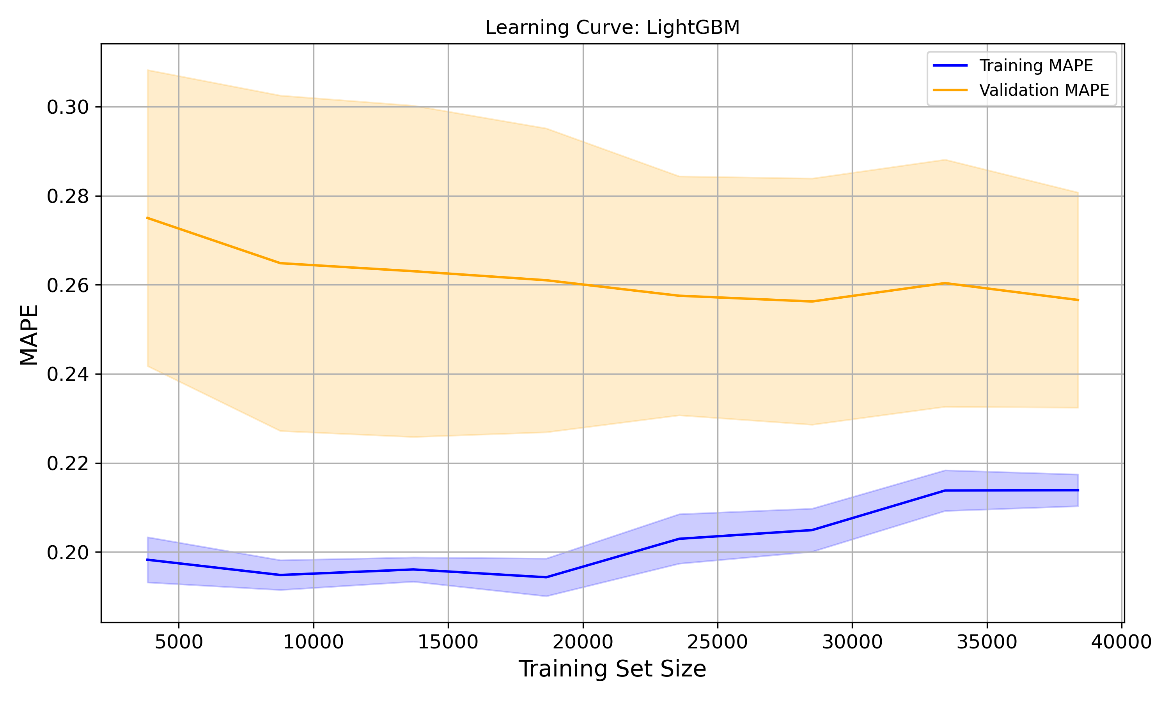
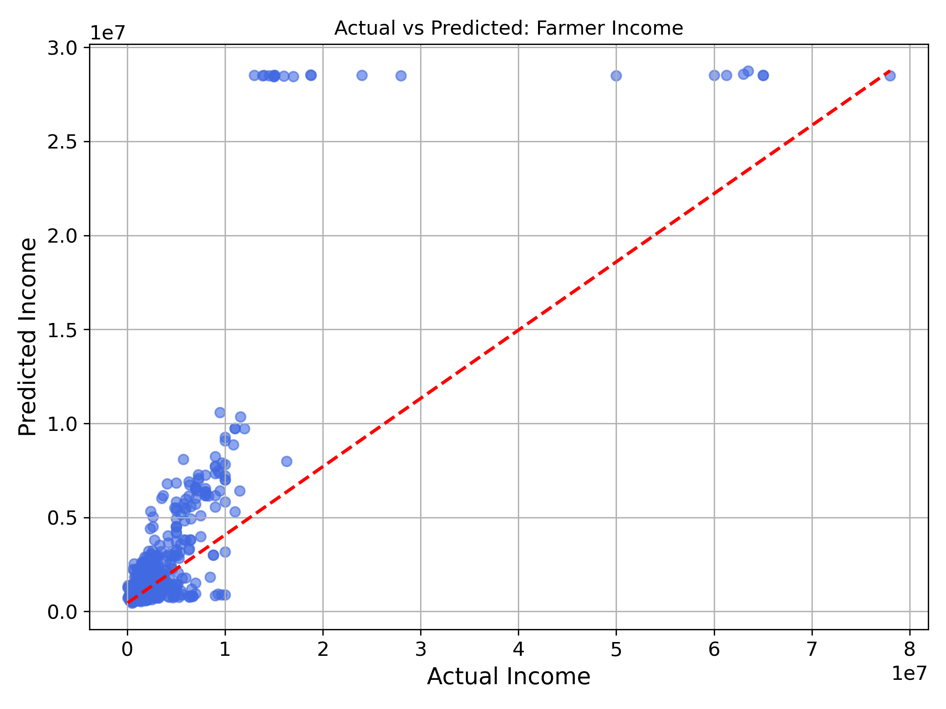
6) Results
Fig. Learning curve for lgbm_model
Fig. Actual vs Predicted income by the lgbm_model

Slide 8
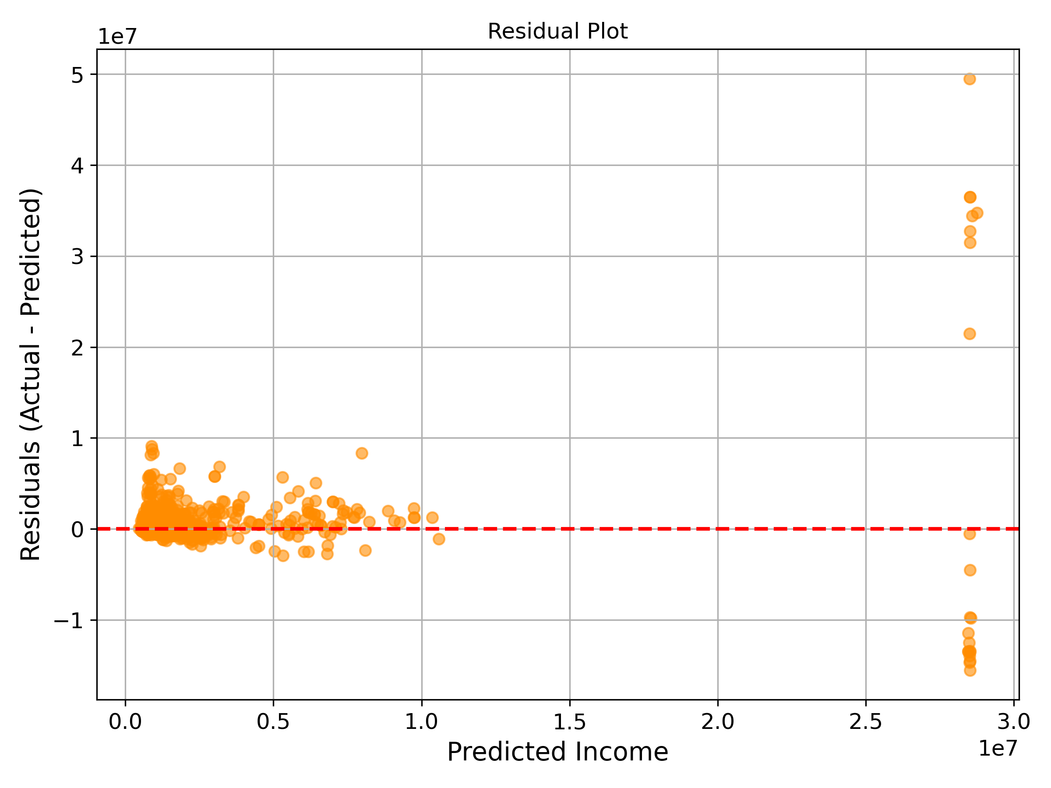
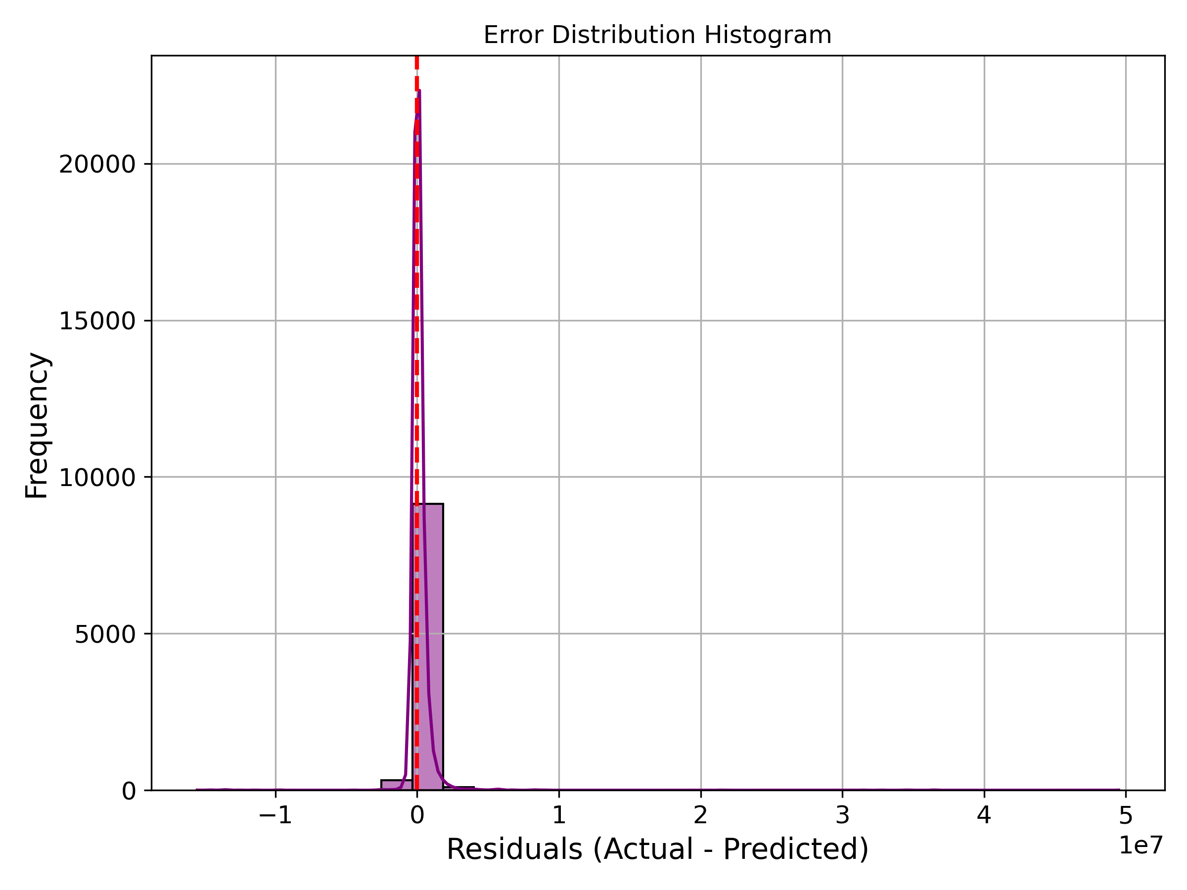
6) Results (contd…)
Fig. Residual plot for lgbm_model
Fig. Error Distribution histogram for lgbm_model

Slide 9
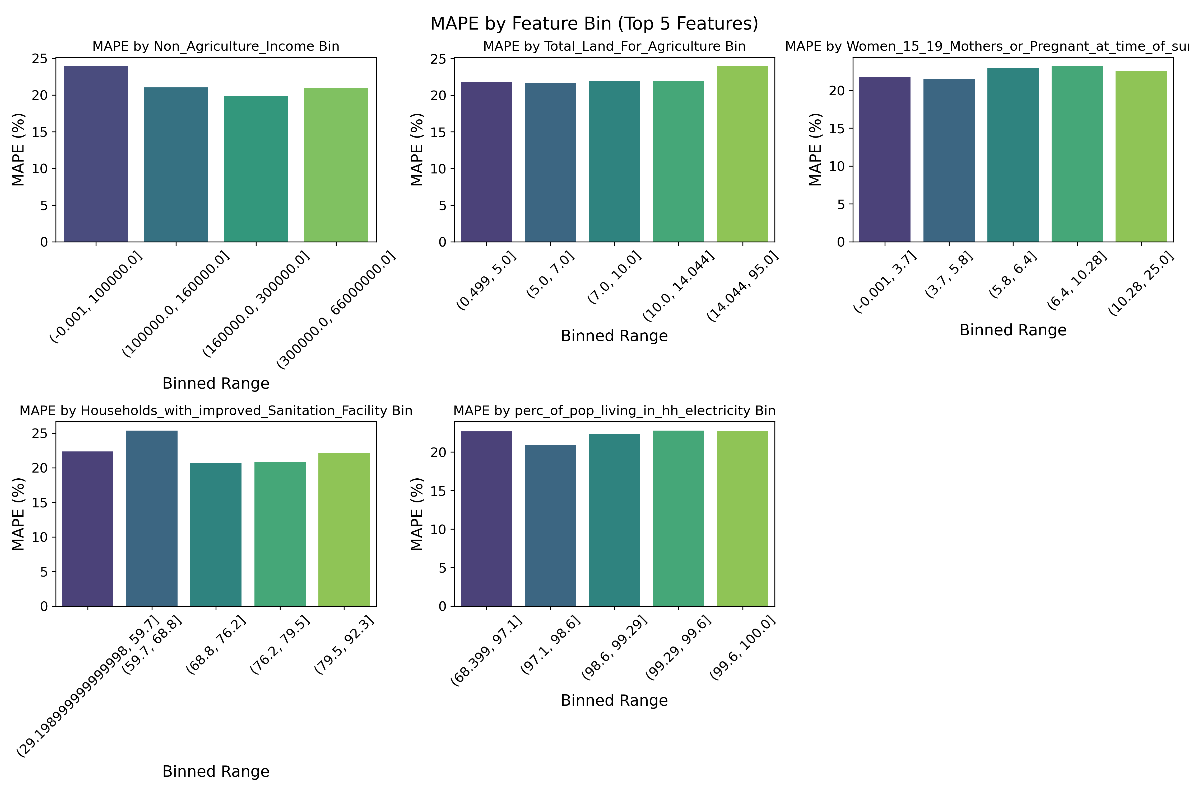
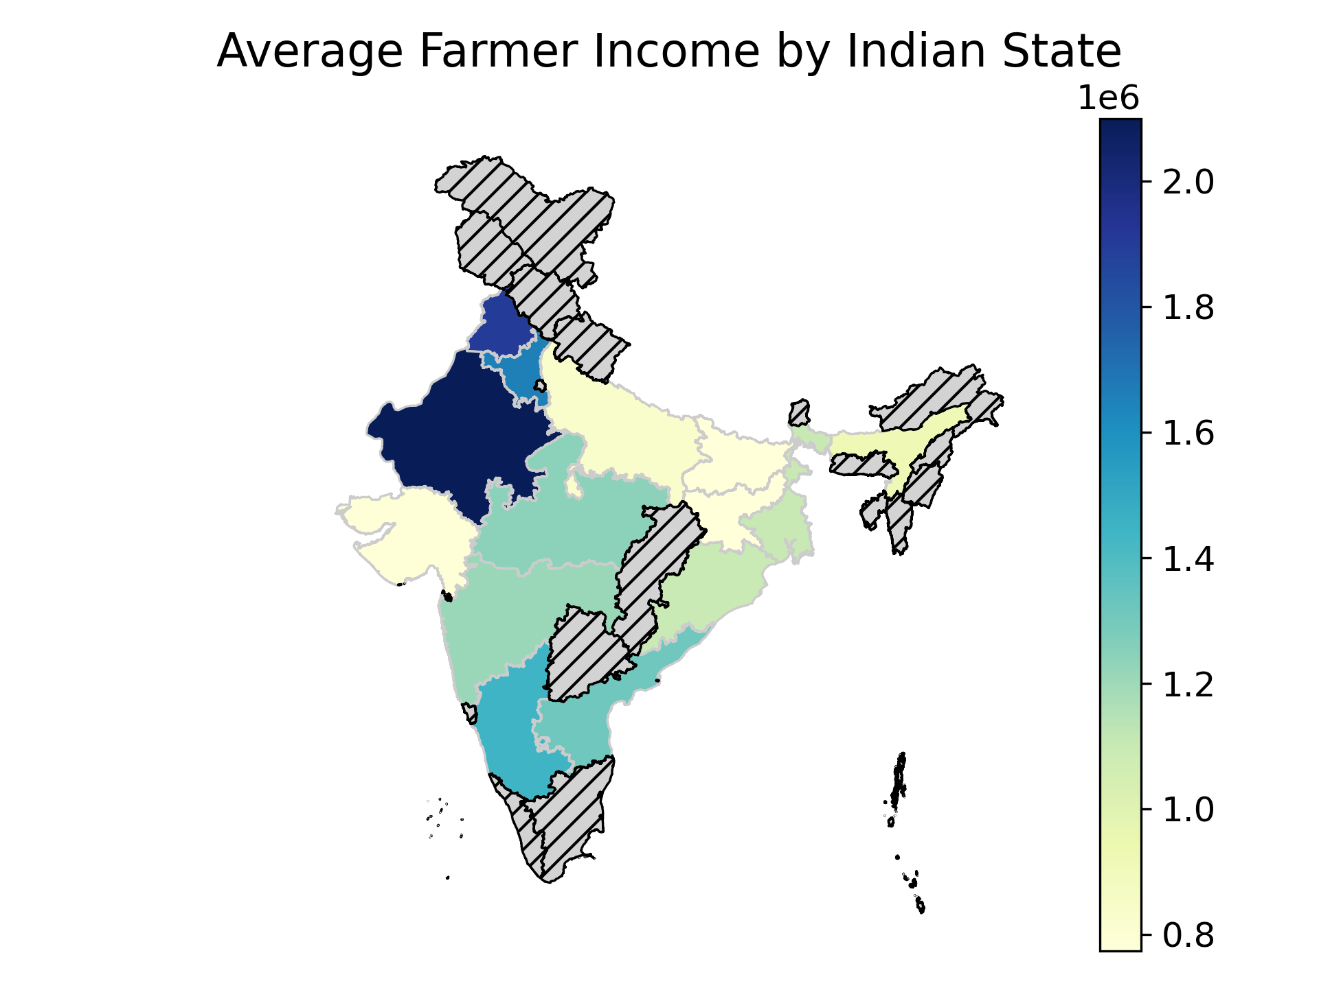
6) Results (contd…)
Fig. MAPE metrics by feature bin (for top 5 features)
Fig. Choropleth of avg. Indian farmer income (by State)

Slide 10
Conclusion
Key takeaways:
Thorough EDA revealed income disparities driven by non-agricultural earnings, land ownership, and household indicators—not just geography.
Robust preprocessing pipeline handled extensive categorical data and missing values across 1700+ features.
Model Insights:
LightGBM with Bayesian Optimization outperformed all other models with a MAPE of ~22.2%.
Optuna-based hyperparameter tuning led to significant gains over naive and stacked baselines.
Random Forest and XGBoost explored as strong contenders but slightly underperformed compared to LightGBM.
Methodological Insights:
Simple random split ensured model generalizability, decoupling predictions from state-based leakage.
Emphasis on interpretable features and importance plots supports practical deployment in the field.
Final Outcome:
Deliverables, including: prediction file, trained model, reproducible code notebook.

